Slide 1
LANDSLIDE DETECTION AND COMMUNICATION NETWORKS
Presented by
Group E1-6
Aniket Doke 12103A0058
Vishwajeet Lokhande 12103A0051
Mayank Kashyap 12103A0049
Sushant Gajankush 12103A0036

Slide 2
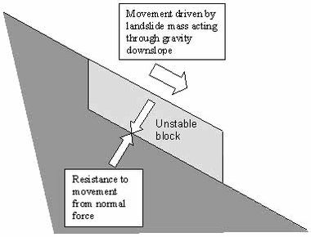
Introduction
A landslide is an catastrophic event where a block of earthen mass slides downhill and disrupts transport pathways.
Landslides cause colossal property damage, pose a threat to railway lines and highways in hilly regions.
Causes:
Earthquake
Seismic activity
Intense Rainfall
Land use (e.g. construction of roads, farms,
houses)
Soil Erosion and many more…
Diagram illustrating the resistance to, and causes of, movement in a slope system consisting of an unstable block

Slide 3
Aims and Objectives
To detect landslide using laser line break sensor and to effectively alert the railway control room in the shortest possible time.
To establish wireless communication networks among landslide affected area, control rooms, railways and provide support to disaster management authorities.
To trigger immediate and fast mitigation activities in order to save as many lives as possible.
To effectively predict the occurrence of a landslide using proximity sensor nodes (FUTURE SCOPE)
To efficiently monitor railroad signals and to turn it red whenever a landslide has been detected.

Slide 4
Methodology (The role of each component is explained here)
Laser Line Break Sensor :
Constant laser beam is always active and running, power sourced from solar cells installed (FUTURE SCOPE)
The sensor nodes are encased in a protective cylindrical structure that is rigid and doesn’t allow low weights to trigger an alert by making sure the beam stays intact.
This encasing also ensures environmental protection of the sensors and breaks under extremely high pressure thus setting off an alert.
Microcontroller Board :
Laser line system is connected to ADC and the digital signal is sent to microcontroller for processing.
We will be using an Arduino Uno/Mega Board for this purpose as it allows creative freedom; which guarantees improvements and additional changes.
ZigBee Wireless Module:
This wireless module is used to transmit this signal and is coupled with the microcontroller board.
Information is then received by nearest control room through necessary software.

Slide 5
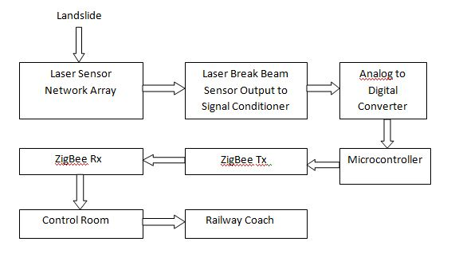
Data Flow Diagram

Slide 6
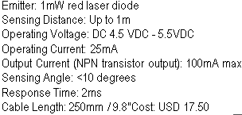
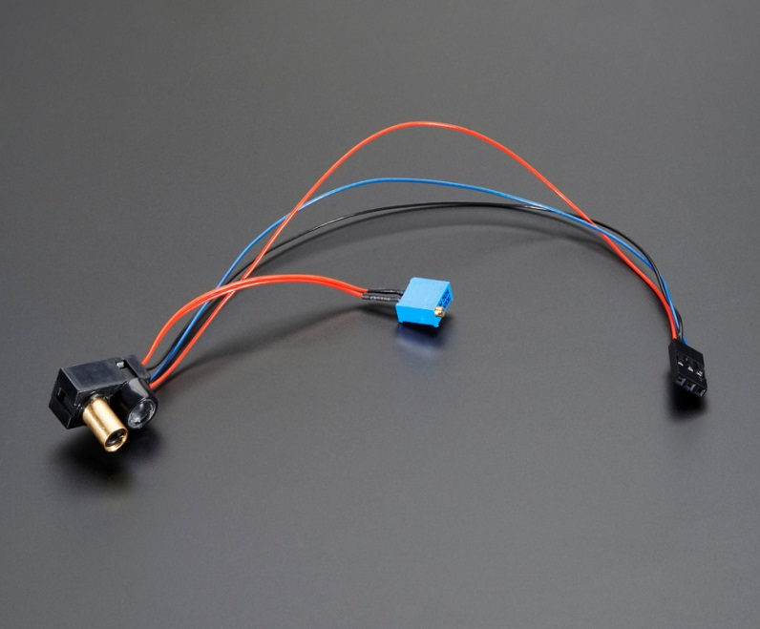
Hardware Requirements: Laser Line Break Sensor

Slide 7
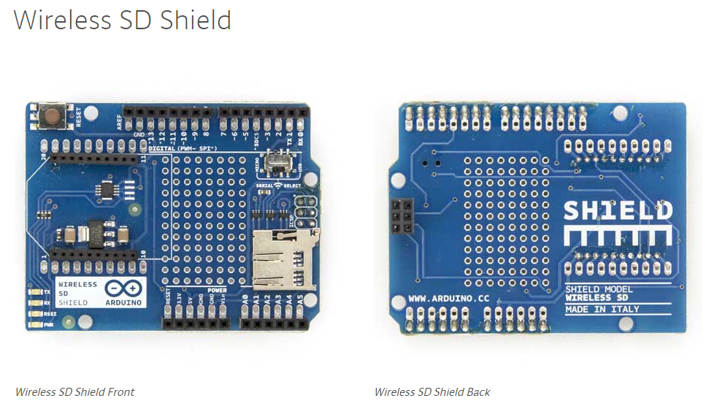
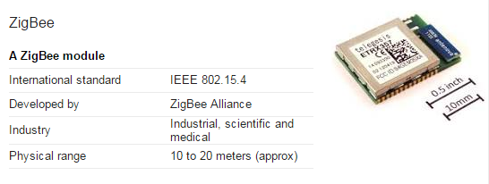
Hardware Requirements: ZigBee Module

Slide 8
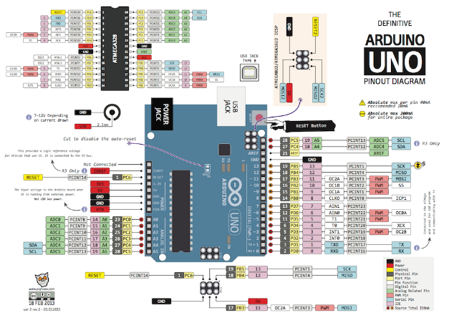
Hardware Requirements: Arduino Uno Board

Slide 9
Software Requirements
XCTU: Next Generation Configuration Platform for Xbee/RF Solutions by Digi International
Arduino Software
Use of IoT concepts into making a website to alert authorities (Future scope)

Slide 10
Scope
The project will consist of real-time monitoring and detection of landslides along railway lines in landslide prone hilly areas and to establish strong communication networks between landslide affected area, control rooms, railways and people.
Smart autonomous self powered wireless sensor networks based low-cost landslide detection system is under the development scheme of Indian Railways which will be incorporated within the landslide prone areas saving the lives of thousands due to instant signals of warning.
Has further scope for implementation in other similar natural disasters such as highways and in snowy regions where avalanches occur very often.

Slide 11
Latest Technologies for prediction and detection of Landslides
FIBRE OPTIC SENSORS
Fiber-optic sensors embedded in shallow trenches within slopes could help detect and monitor both large landslides and slow slope movements.
Fiber-optic sensors are more robust, economical and sensitive.
Distributed optical fiber sensors can act as a ‘nervous system' of slopes by measuring the tensile strain of the soil they're embedded within.
WIRELESS SENSOR NETWORKS
Design of some wireless sensor monitoring nodes are distributed on the hillside
This design combines GSM wireless communication technology and wireless sensor network, it have completed the work from the system solution to the whole process of software and hardware design.

Slide 12
Thank You

